Slide 1



HEART AND VASCULAR DISEASE IN WOMEN:
Targeted Key Messages
CWHHA.ca • #HerHeartMatters

Slide 2



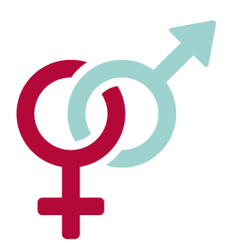



HEART AND VASCULAR
DISEASE IS ON THE RISE
Heart attack symptoms are not recognized in over 50% of women.
Women and men can have different types of heart and vascular disease.
Women can be at greater risk for heart and vascular
disease than men.
There is a lot we can all do to help reduce the risk.
To take care of others, you need to first take care of yourself.
Start the conversation with the women in your life.
IT’S THE LEADING CAUSE OF DEATH FOR WOMEN WORLDWIDE
Questions? Visit CWHHA.ca or your healthcare provider.

Slide 3
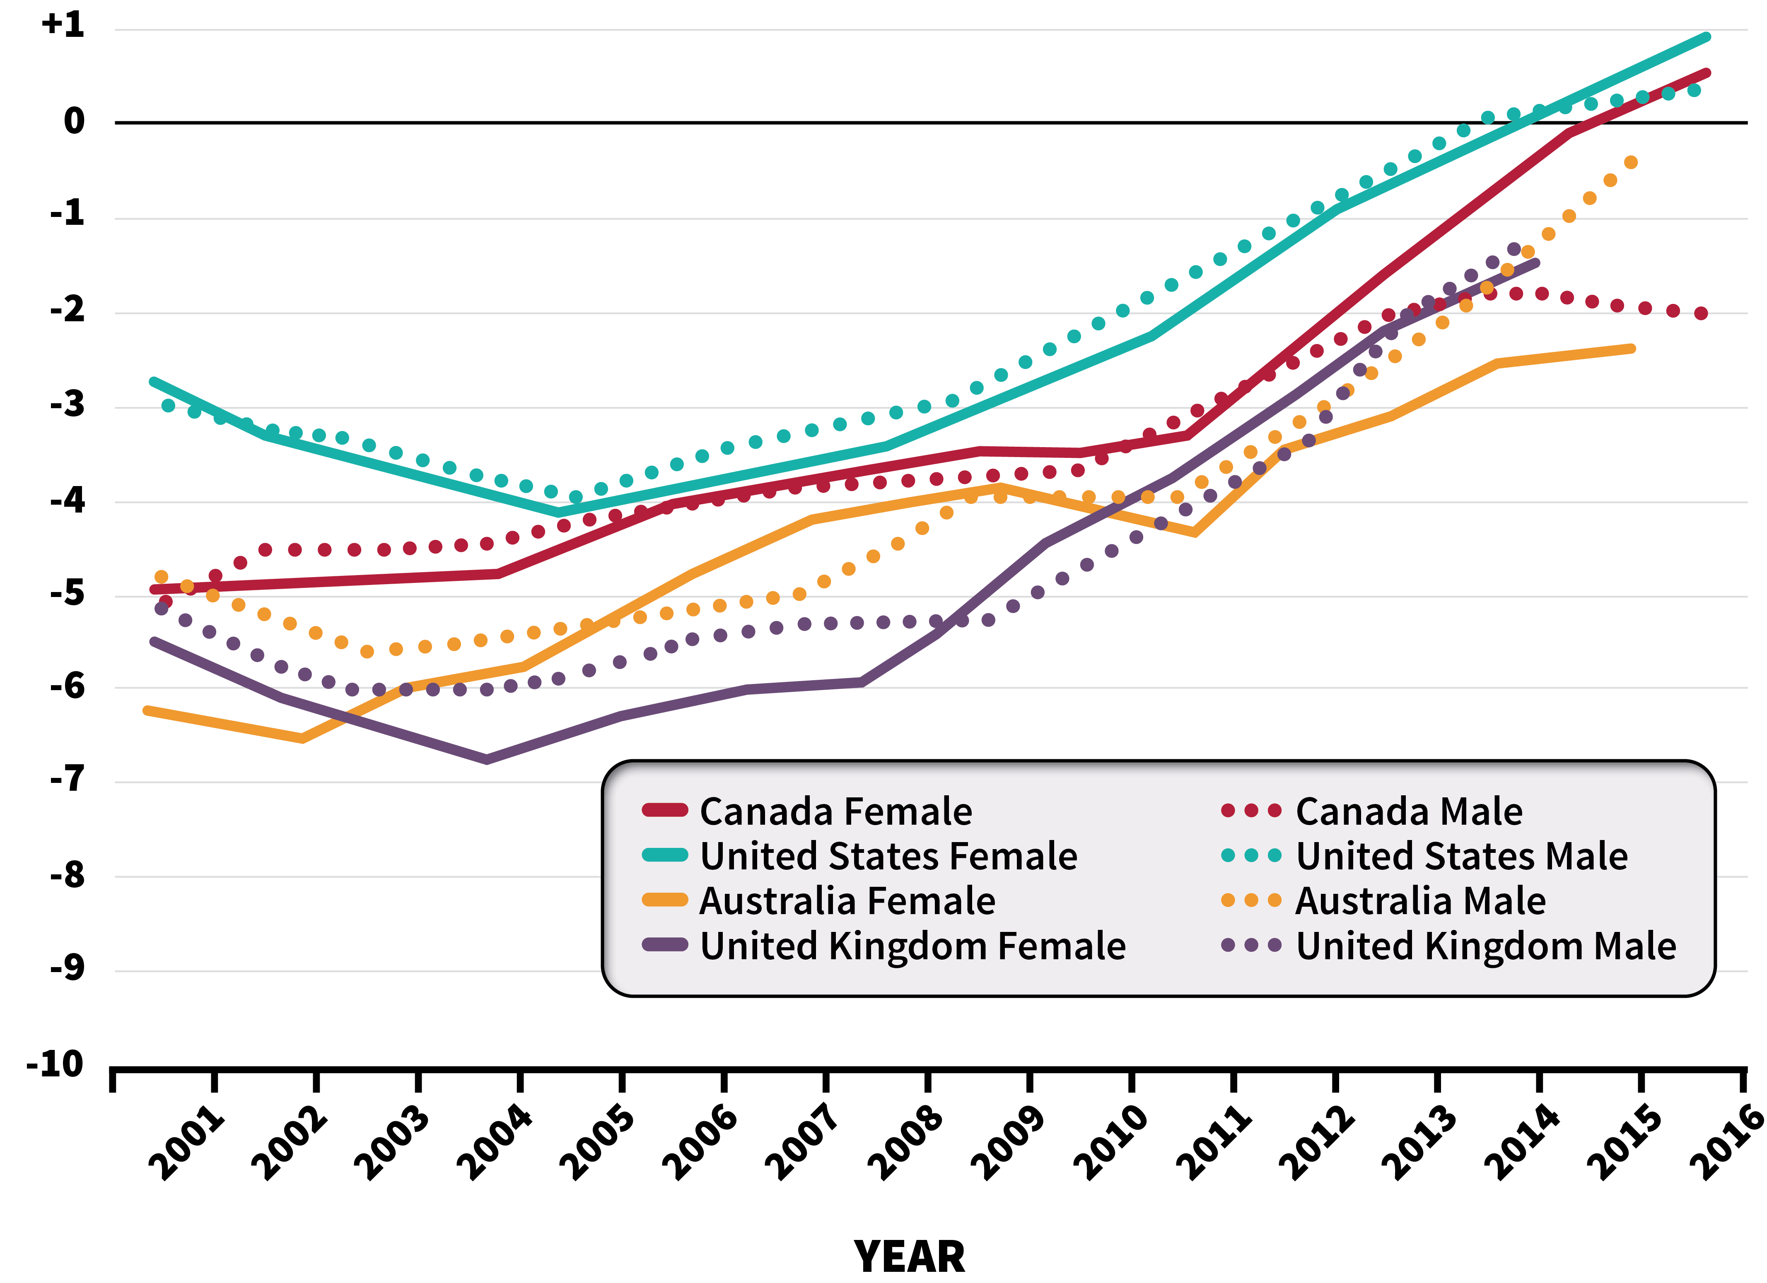
KEY MESSAGE # 1
VITAL STATISTICS FROM THE
WORLD HEALTH ORGANIZATION MORTALITY DATA
Heart and vascular is on the rise and is the leading cause of death for women worldwide.
% CHANGE IN AGE-STANDARDIZED DEATH RATES
QUESTIONS?
Visit CWHHA.ca or your healthcare provider.
Lopez et al. Int J Epidemiol, 2019, 1815-1823.
Notes:
Reference: Lopez et al. Int J Epidemiol, 2019, 1815-1823

Slide 4

KEY MESSAGE # 2
Heart attack symptoms are not recognized in over 50% of women.
SYMPTOMS OF HEART ATTACK MOST OFTEN REPORTED BY WOMEN
Chest pain or discomfort
(e.g., pressure, tightness, or burning)
Pain spreading from the chest or neck, jaw, arm and/or back, stomach
Abnormal excessive sweating
Shortness of breath
Stomach pain or discomfort, or feelings of nausea or indigestion
3+
Women are more likely to present with 3 or more symptoms in addition to chest pain.
OTHER ACCOMPANYING OR ASSOCIATED SYMPTOMS
If you think someone is having a heart attack, seek immediate medical attention.
Unusual weakness or fatigue
Back, shoulder, or right arm pain
Sleep disturbance
Dizziness or light-headedness
Fast or irregular heartbeat
Lichtman JH, et al. Circulation. 2018;137:781–790
Notes:
Reference: Norris CM, et al. J Am Heart Assoc 2020 Feb 16; 9(4): e015634.

Slide 5

KEY MESSAGE # 3
Causes of heart and vascular disease
can be
different
for women
than men.
Some health providers may be less aware of the differences between women and men.
Common causes of heart and vascular disease:
Coronary artery disease
Valvular heart disease
Arrhythmia (irregular heart beat)
Women are more likely than men to have:
Spontaneous coronary artery dissection (SCAD)
Coronary vasospasm
Microvascular dysfunction (small-vessel disease)
Takotsubo (stress-induced) cardiomyopathy (disease of the heart muscle)
Peripartum cardiomyopathy (weakened heart during or after pregnancy)
Questions? Visit CWHHA.ca
Norris CM, et al. J Am Heart Assoc 2020 Feb 16; 9(4): e015634.
Notes:
Reference: Norris CM, et al. J Am Heart Assoc 2020 Feb 16; 9(4): e015634.
Stroke and Vascular Cognitive Impairment

Slide 6
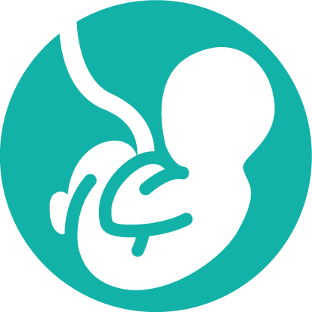
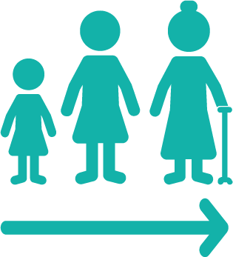
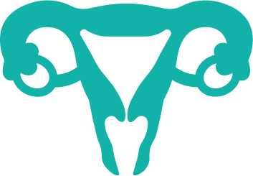



KEY MESSAGE # 4
Women can be at greater risk for heart and vascular than men.
The following conditions lead to a greater risk of heart and vascular disease:
Certain pregnancy complications
(ex. Premature birth, diabetes or hypertension during pregnancy, preeclampsia)
Earlier menopause (Before age 40)
Polycystic ovary syndrome
Systemic inflammatory and autoimmune disorders
(ex. Rheumatoid arthritis, lupus)
Cigarette smoking
(Women have 3x higher risk of heart attack due to cigarette smoking compared to men)
Diabetes mellitus
(Women living with diabetes are 3x more likely to die from heart disease compared to men)
Questions? Visit CWHHA.ca or your healthcare provider.
Garcia, M. et al. (2016). Circ Res, 118(8), 1273-1293.
Yusuf, S. et al. (2004). Lancet, 364(9438): 937-52.
Notes:
Reference: Garcia, M. et al. (2016). Circ Res, 118(8), 1273-1293 Yusuf, S. et al. (2004). Lancet, 364(9438): 937-52.

Slide 7







KEY MESSAGE # 5
There is a lot we can do to help reduce the risk.
Be active,
keep moving
Eat a variety of healthy foods
Manage
stress
Live free from
commercial tobacco and vaping
Limit
alcohol
Get regular check ups
(test for blood sugars, blood pressure and cholesterol)
Questions? Visit CWHHA.ca or your healthcare provider.
Hu, F. B., et al (2000). New England Journal of Medicine, 343(8), 530-537
Yusuf, S. et al (2004). Lancet, 364(9438):937-52
Notes:
Reference: Hu, F. B., et al (2000). New England Journal of Medicine, 343(8), 530-537.

